Slide 1
Customer Segmentation Online Retail
- AGUNG ADI PUTRA -

Slide 2
OUTLINE
01
INTRODUCTION
02
SYSTEM MODEL
03
RESULT
04
CONCLUSION

Slide 3

INTODUCTION
BACKGROUND, RESEARCH PURPOSE, SCOPE OF PROBLEM
Notes:
This section consist of …….

Slide 4
Research Purpose
Data Set
Algorithm
Segment
Online Retail transaction in UK
K-means Clustering
marketing strategy effectively

Slide 5
SYSTEM MODEL

Slide 6
Block Diagram
Power
Transformer
Standard Scaler
principal component analysis
K-means

Slide 7
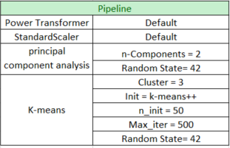
Algorithm C

Slide 8
Result Scenario

Slide 9
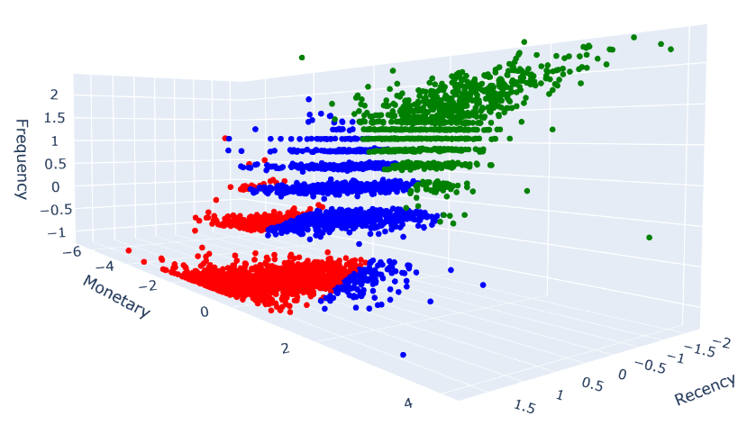
Red (Cluster 0) : Medium Loyality ( Baru-baru ini membeli)
- Green (Cluster 1) : Low loyality ( Sudah lama tidak membeli)
- Blue (Cluster 2) : High Loyality ( Sering membeli dan memberikan revenue terbanyak)

Slide 10
Conclusion and Suggestion

Slide 11
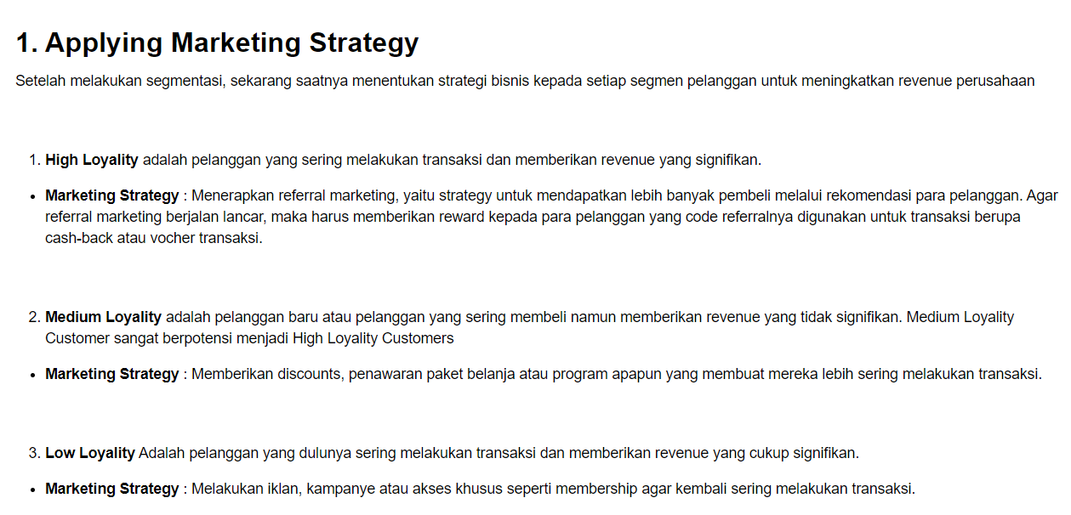

Slide 12
Thank You

